Slide 1
Presentation of a graph
05/12/2022
1

Slide 2
Contents
Introduction
Background info, (How the work was done)
Presentation of the issue
General presentation
Conclusion
05/12/2022
2

Slide 3
Introduction
Daniel Gaël, Djafer Noah, Fouché Joffrey
Vocabulary :
SQL
Data Base
Table
05/12/2022
3

Slide 4
Background info
(How the work was done)
1) CREATE + INSERT
CREATE TABLE DBATIMEREF_CODE
(CODE VARCHAR2(10) PRIMARY KEY, CODENAME VARCHAR2(100));
INSERT INTO DBATIMEREF_CODE VALUES('B', 'BEGIN');
2) Integration of datas : SQL Loader
05/12/2022
4

Slide 5
Background info
(How the work was done)
3) SELECT (Search of datas)
SELECT to_char(BEGINDATE,'YYYY/MM/DD HH24:MI:SS')
FROM DBATIMEREF_DELTATIME_LOAD
WHERE ID=40 AND CODE='B';
Result : 2020/03/27 18:00:01
4) Work report
05/12/2022
5

Slide 6
Presentation of the issue
1) CREATE + INSERT
2) Integration of datas : SQL Loader
3) SELECT (Search of datas)
4) Work report
05/12/2022
6

Slide 7
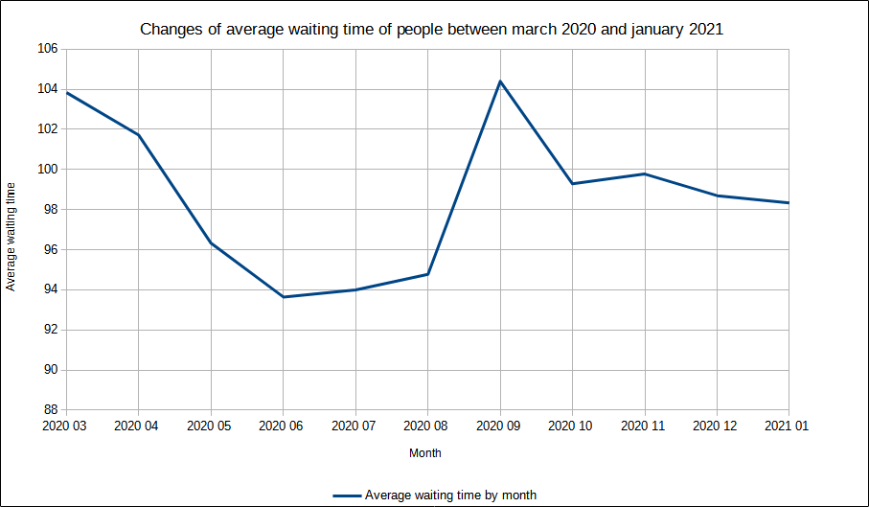
General presentation
05/12/2022
7

Slide 8
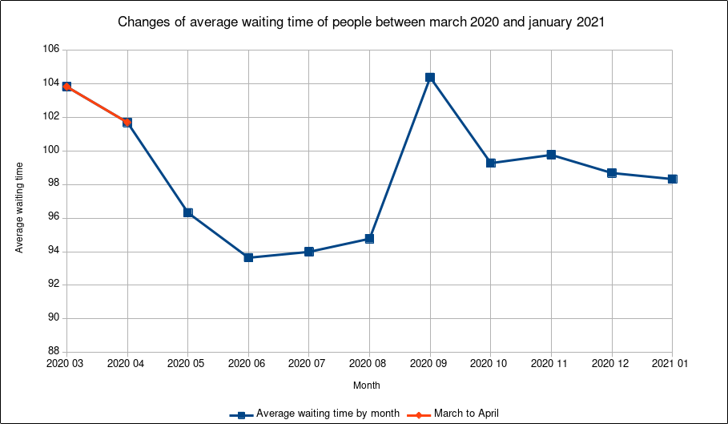
05/12/2022
8

Slide 9
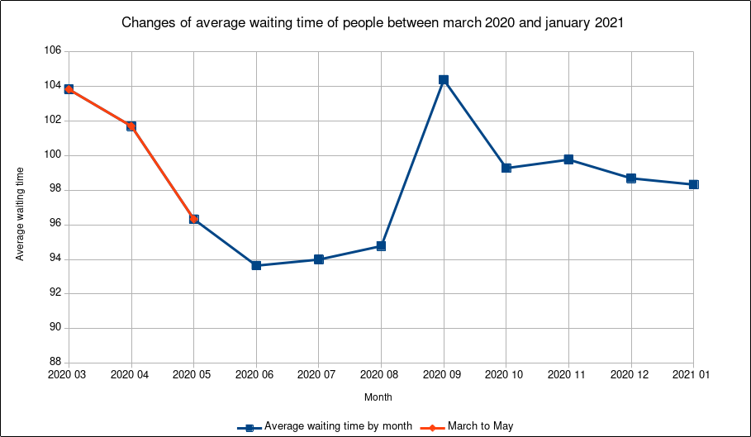
05/12/2022
9

Slide 10
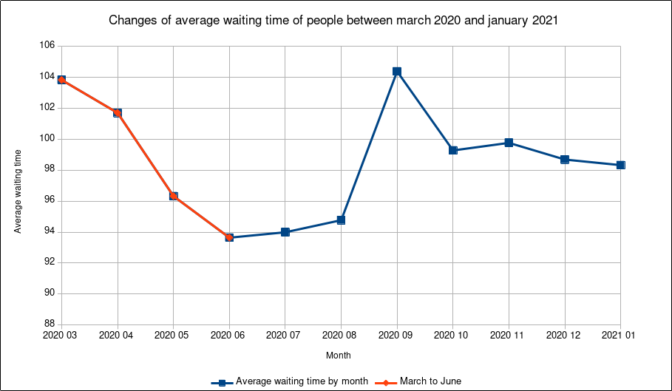
05/12/2022
10

Slide 11
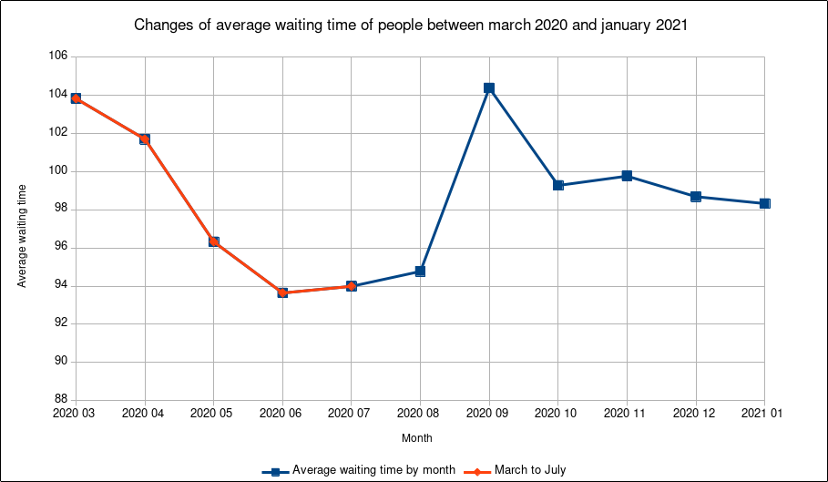
05/12/2022
11

Slide 12
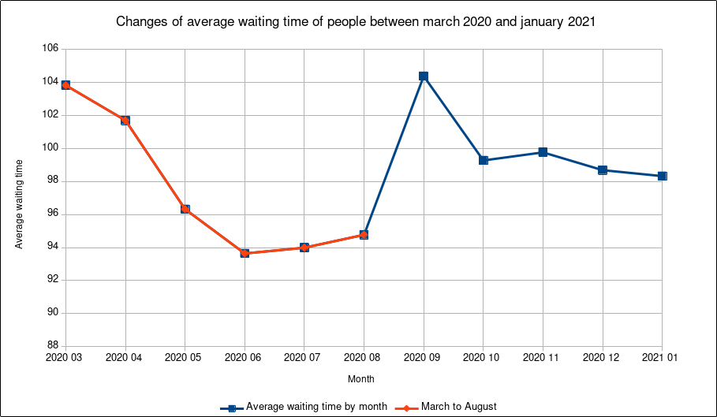
05/12/2022
12

Slide 13
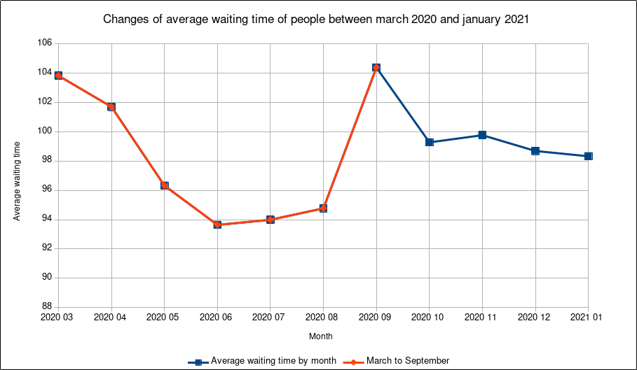
05/12/2022
13

Slide 14
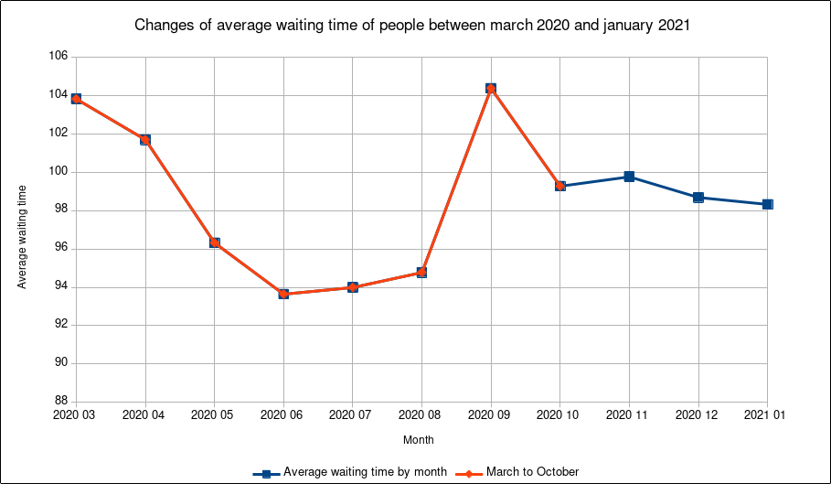
05/12/2022
14

Slide 15
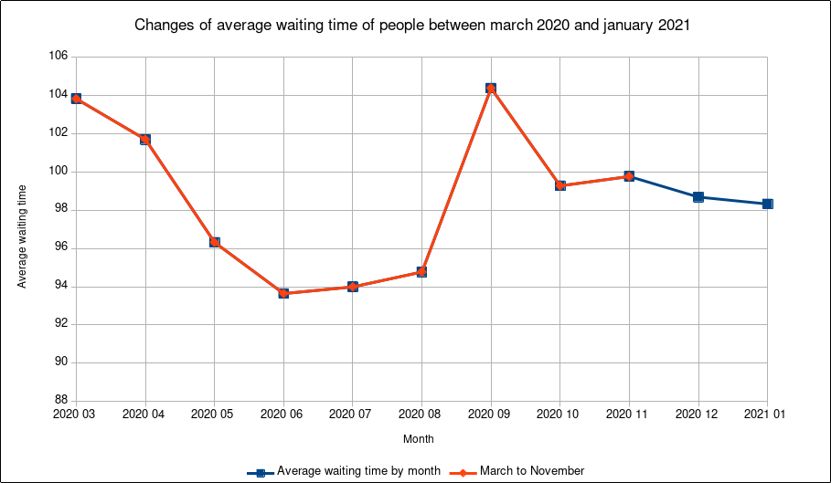
05/12/2022
15

Slide 16
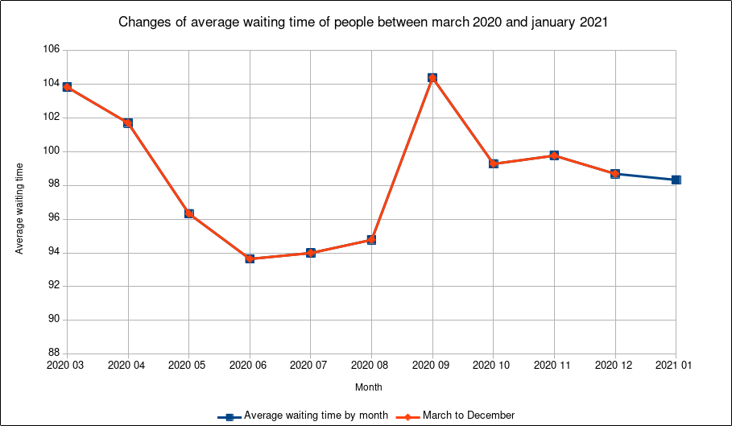
05/12/2022
16

Slide 17
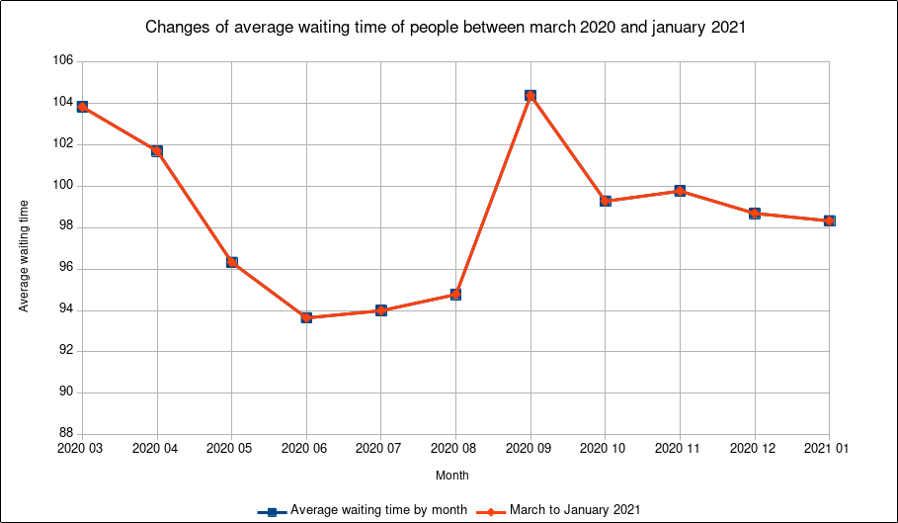
05/12/2022
17

Slide 18
Conclusion
Thanks for listening
05/12/2022
18

